Slide 1
Oracle 10g Installation
Parameswari
Learning and Development

Slide 2
Agenda
Day 1
  Oracle 10g Installation
  Introduction to SQL constructs
  Using SQL*Plus
  Joining Oracle tables
Day 2
  Aggregation in SQL
  SQL access methods
  SQL Subqueries
  Times, Dates, and Strings
Day 3
  Basics of PL/SQL
  PL/SQL structures
  Stored procedures, functions and packages

Slide 3
ORACLE 10g Installation

Slide 4
Download - Software
Prior to downloading files from Oracle, you will have to register as an Oracle user.
The Oracle 10g database can be downloaded from
  http://www.oracle.com/technology/software/products/database/index.html
If you have not registered, you will be asked to.
There is one file for this download that can be saved on a CD for later use if needed.
Select the appropriate file for your operating system.
For Windows select:
  Oracle Database 10g Release 2 (10.2.0.1.0) for Microsoft Windows

Slide 5
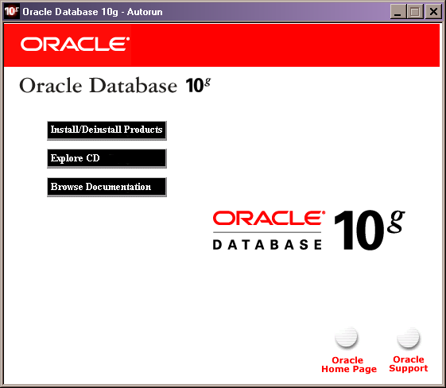
This is the first screen for Oracle 10g installation. With it you can install or remove Oracle products
Slide1

Slide 6
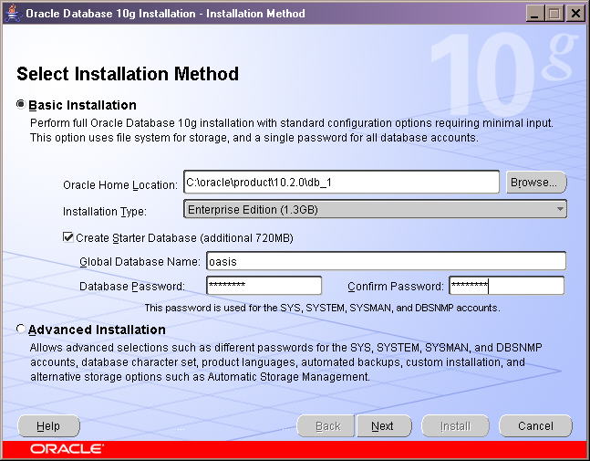
This is where the Oracle installation files will be installed.
Slide2
This is the name chosen for this database instance example.

Slide 7
Note: A network warning message can occur at this point while installing the database. See the message below.
How to install the Microsoft Loopback Adapter
Message:
Checking Network Configuration requirements ...
Check complete. The overall result of this check is: Failed <<<<
Problem: The install has detected that the primary IP address of the system is DHCP-assigned.
Recommendation: Oracle supports installations on systems with DHCP-assigned IP addresses; However, before you can do this, you must configure the Microsoft LoopBack Adapter to be the primary network adapter on the system.
See the Installation Guide for more details on installing the software on systems configured with DHCP.
=======================================================================
The Microsoft Loopback adapter is a testing tool for a virtual network environment where network access is not available. Also, you must use the Loopback adapter if there are conflicts with a network adapter or with a network adapter driver. You can bind network clients, protocols, and other network configuration items to the Loopback adapter, and you can install the network adapter driver or network adapter later while retaining the network configuration information. You can also install the Loopback adapter during the unattended installation process.
To manually install the Microsoft Loopback adapter in Windows XP, follow these steps:
1.Click Start, and then click Control Panel.
2.If must not be in Classic view. Under Folder Options, General, change to ‘Show common Tasks in folders’.
3.Unedr Pick a category, double-click Printers and Other Hardware.
4.Under See Also in the left pane, click Add Hardware, and then click Next.
5.Click Yes, I have already connected the hardware, and then click Next.
6.At the bottom of the list, click Add a new hardware device, and then click Next.
7.Click Install the hardware that I manually select from a list, and then click Next.
8.Click Network adapters, and then click Next.
9.In the Manufacturer box, click Microsoft.
10.In the Network Adapter box, click Microsoft Loopback Adapter, and then click Next.
11.Click Finish.
After the adapter is installed successfully, you must manually configure its options. If the TCP/IP properties are configured to use DHCP, the adapter will eventually use an autonet address (169.254.x.x/16) because the adapter is not actually connected to any physical media.
Note By default, TCP/IP properties are configured to use DHCP.
Set the configuration option to manual configuration for the IP address.
Set it to the number shown in the Control Panel, eg: 169.254.25.129. (Use: Control Panel/Network and Internet Connections/Network Connections)

Slide 8
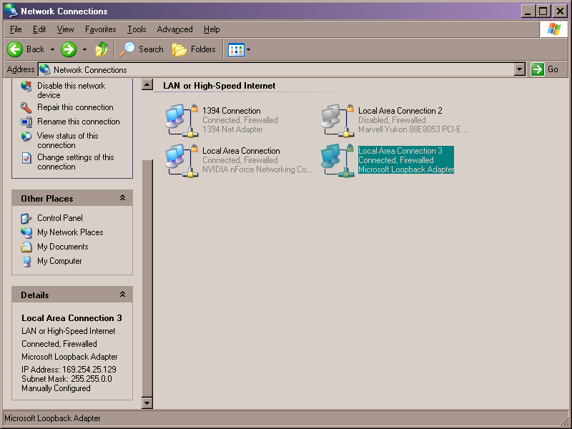
This shows that the Microsoft Loopback Adapter has been installed
The details of the Loopback Adapter

Slide 9
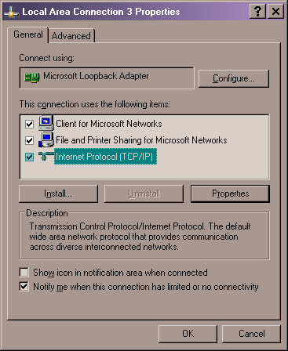
Once the Loopback Adapter has been installed, right-click the mouse and this pop-up will appear. Left-click Internet Protocol (TCP/IP), and then left-click Properties

Slide 10
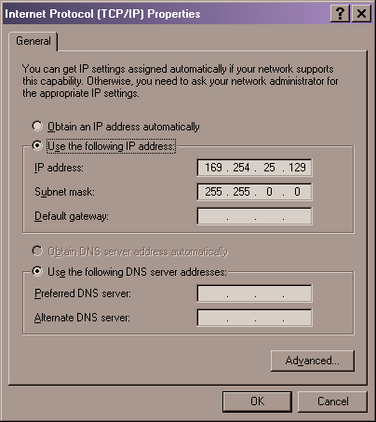
Enter the details from the Control Panel for the Loopback Adapter and manually configure it as shown. Then click ok.

Slide 11
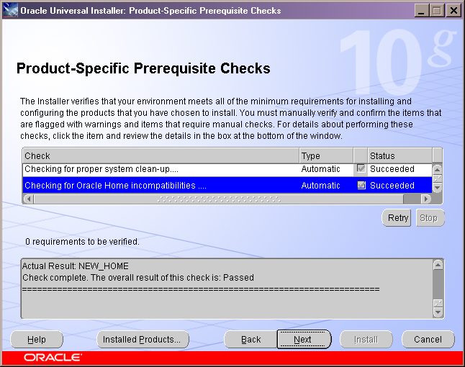
This shows the progress of checking your computer prior to installing the database.
Slide3
Checking complete. No problems encountered

Slide 12
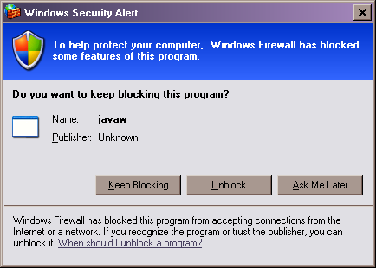
This is a Windows XP alert, not an Oracle alert.
Slide4
Unblocking should be chosen so that the database files can be installed.

Slide 13
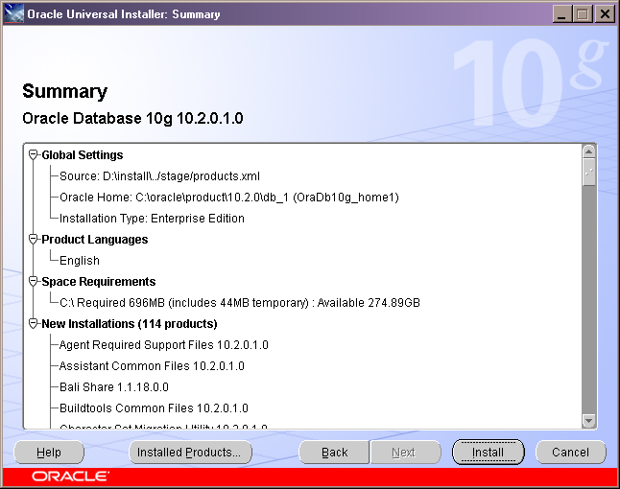
This screen shows a summary of all the information collected prior to the actual installation.
Slide5

Slide 14
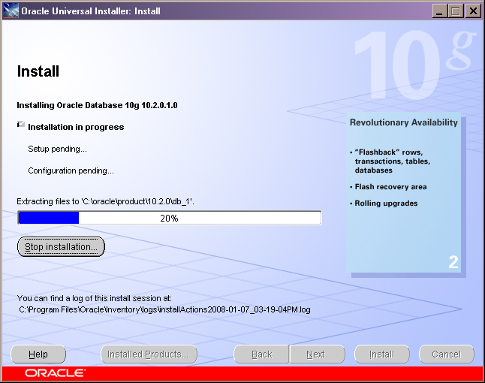
The actual installation is now taking place. This can take about five minutes on 2008 desktops until completed.
Slide6

Slide 15
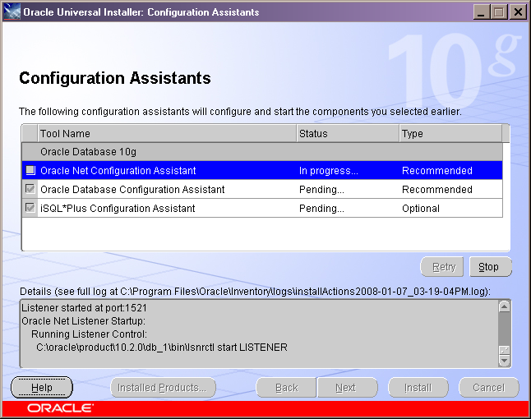
This slide just informs you that these tools will be started.
Slide7

Slide 16
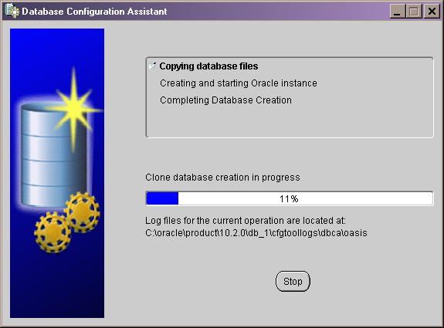
This shows the progress of configuring the new database instance, OASIS.
Slide8

Slide 17
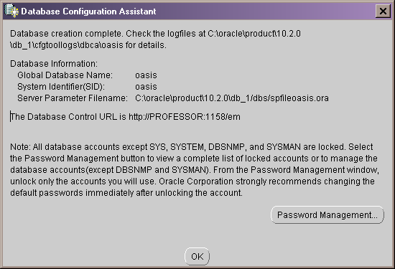
The configuration of the database is now complete.
Slide9

Slide 18
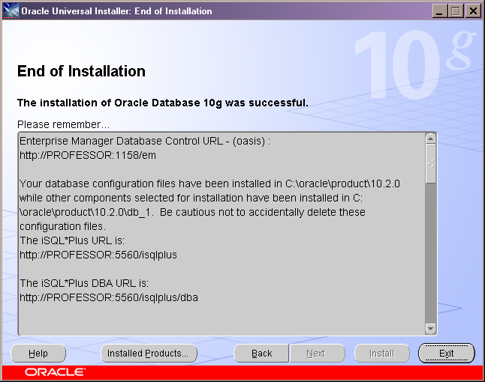
The end of the installation
Slide10

Slide 19
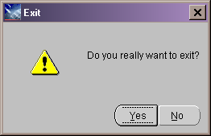
The installation process can now be exited, or you can install another instance e.g.. EDEN as opposed to OASIS.
Slide11

Slide 20

Once the database has been installed, you should set up some new userids. Note, you should not use SYS or SYSTEM for your project.
  Open SQLPlus screen under:
    Start/Programs / Start/Programs/Oracle-OraDb10gHome_1/Application Development/SQL Plus
    using the SYSTEM userid.
  Create a userid called ‘root’ and grant it DBA privileges.
    Create user root identified by password;
    Grant dba to root;
  Shut down the database and open it again as root.
  Create a userid that you want to use in your database for your project and grant it connect and resource privileges.
    Create user username identified by password;
    Grant connect, resource to username;
  Now shutdown the database and reconnect as username. Your project should be done using the username userid. Root should only be used to perform anything that needs dba priviliges.

Slide 21
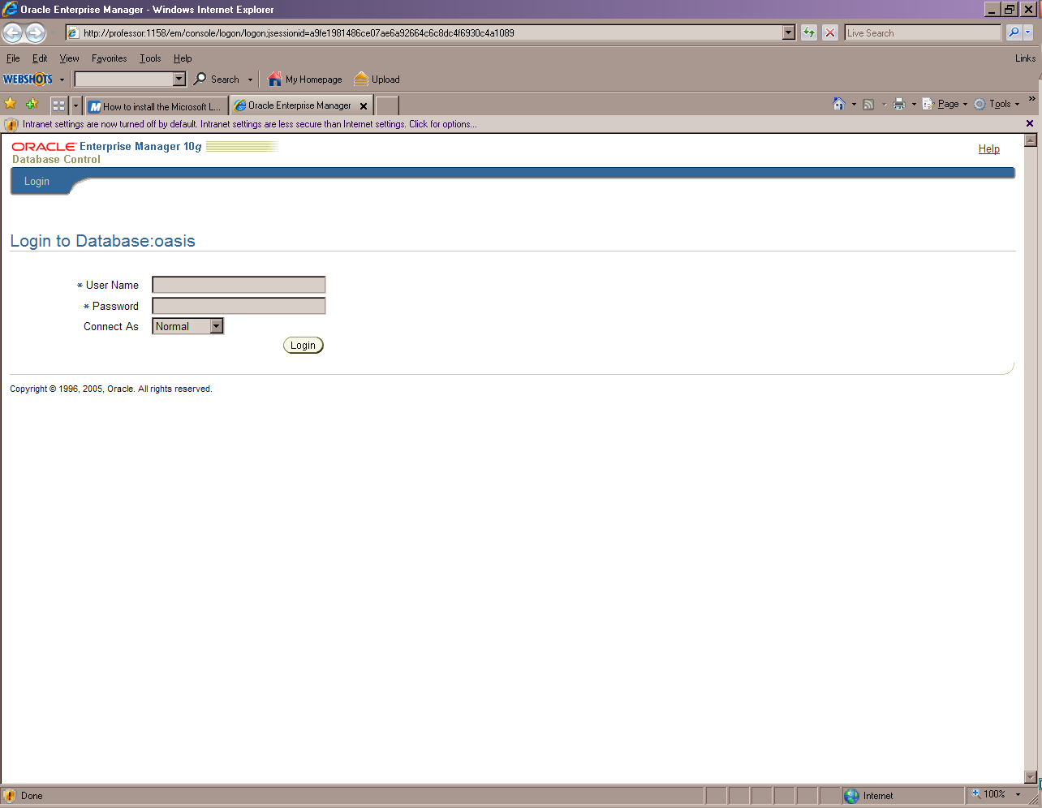
This is the Enterprise Manager 10g screen, which appears as an html object under Microsoft Explorer
Slide12
This screen allows you to Login to the Database instance OASIS. It can be found under: Start/Programs/Oracle-OraDb10gHome_1/Database Control-Oasis
In order to start the database you must use a userid that has DBA privileges. Seen Slide 2 in this series. It is suggested that you log on as ROOT using the password entered from the previous slide. For ‘ConnectAs’ select SYSDBA.
Note: You do not have to open the database in this manner. This is required for a database that has many users and is accessed from different locations over a network. This slide and the following slides are for your information only. Use the SQL Plus screen to do your work.

Slide 22
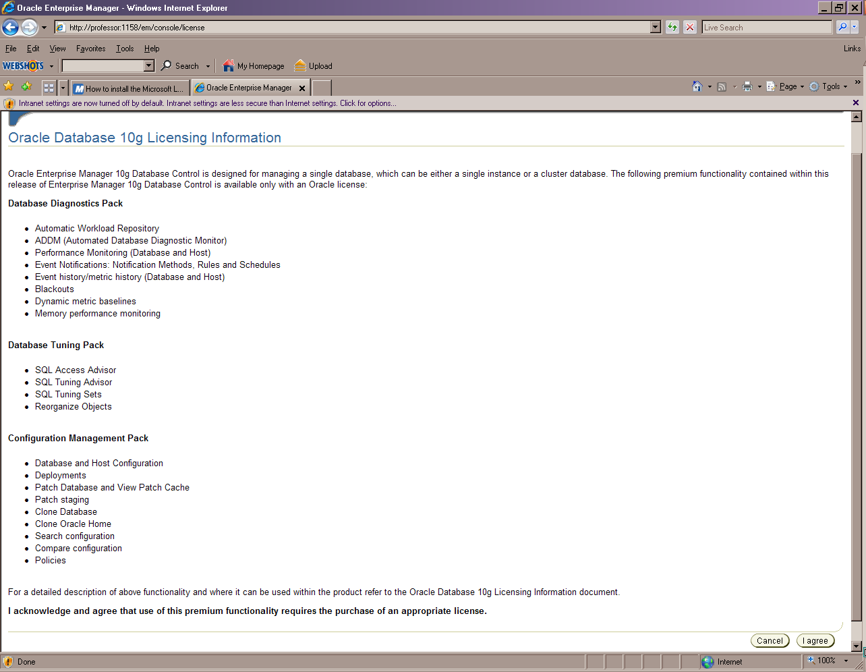
Slide13
This screen just shows the Oracle 10g licensing agreement. Hit the ‘I Agree’ button.

Slide 23
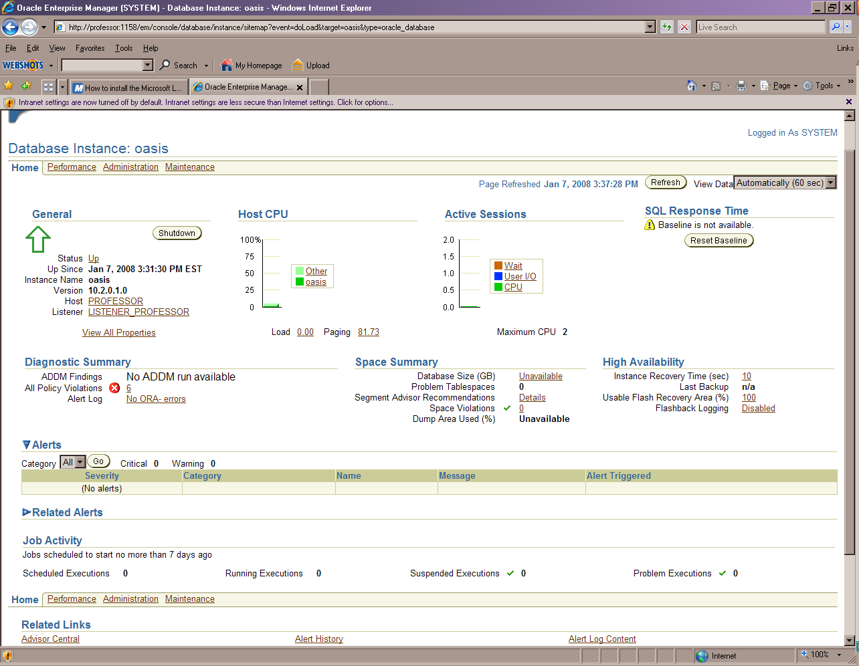
This screen shows database activity
Slide14

Slide 24
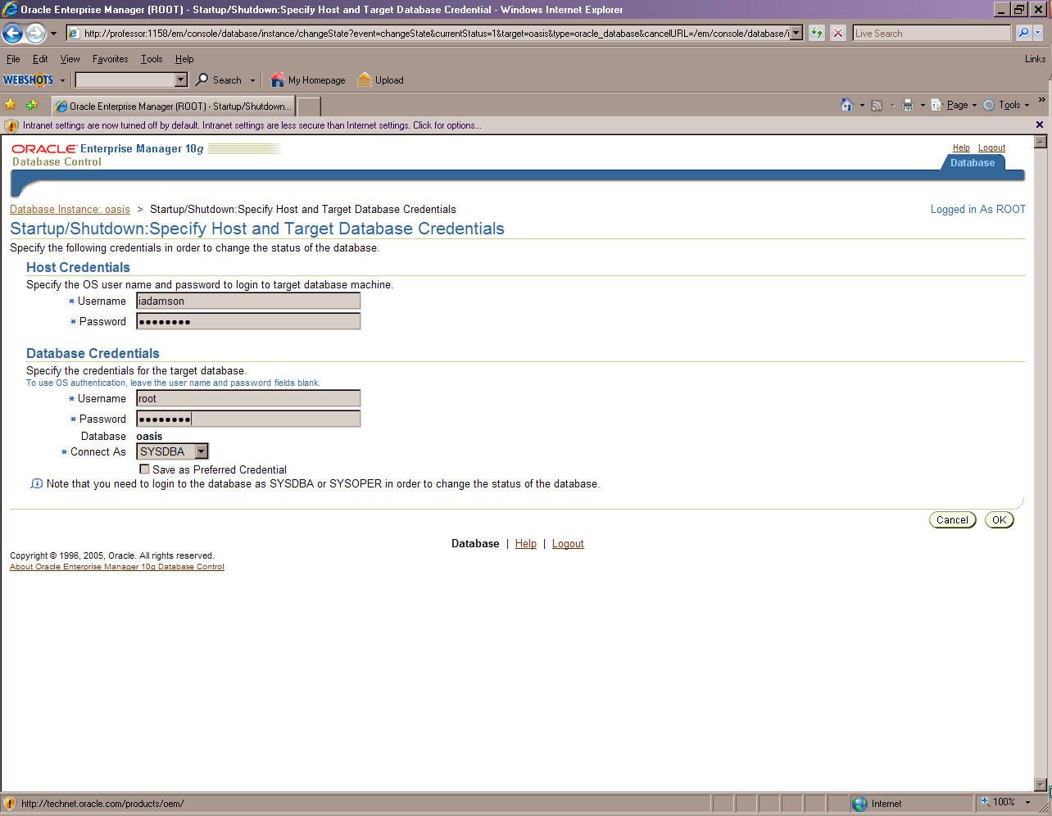
This is the shutdown screen for the database instance
Slide15
Windows Operating System e.g. XP
Database username. Must have DBA privileges
Once the passwords are entered, hit ‘OK’.

Slide 25
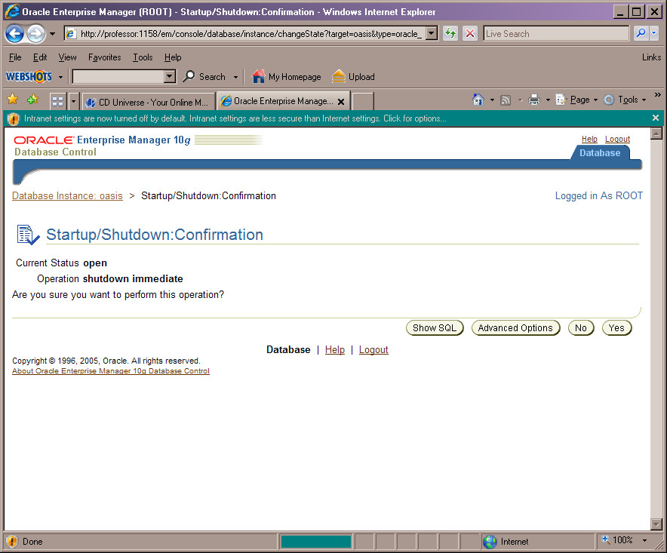
Slide16
This is just confirmation that the database is going to shutdown. It gives you the final option of whether or not you want to shut it down.

Slide 26
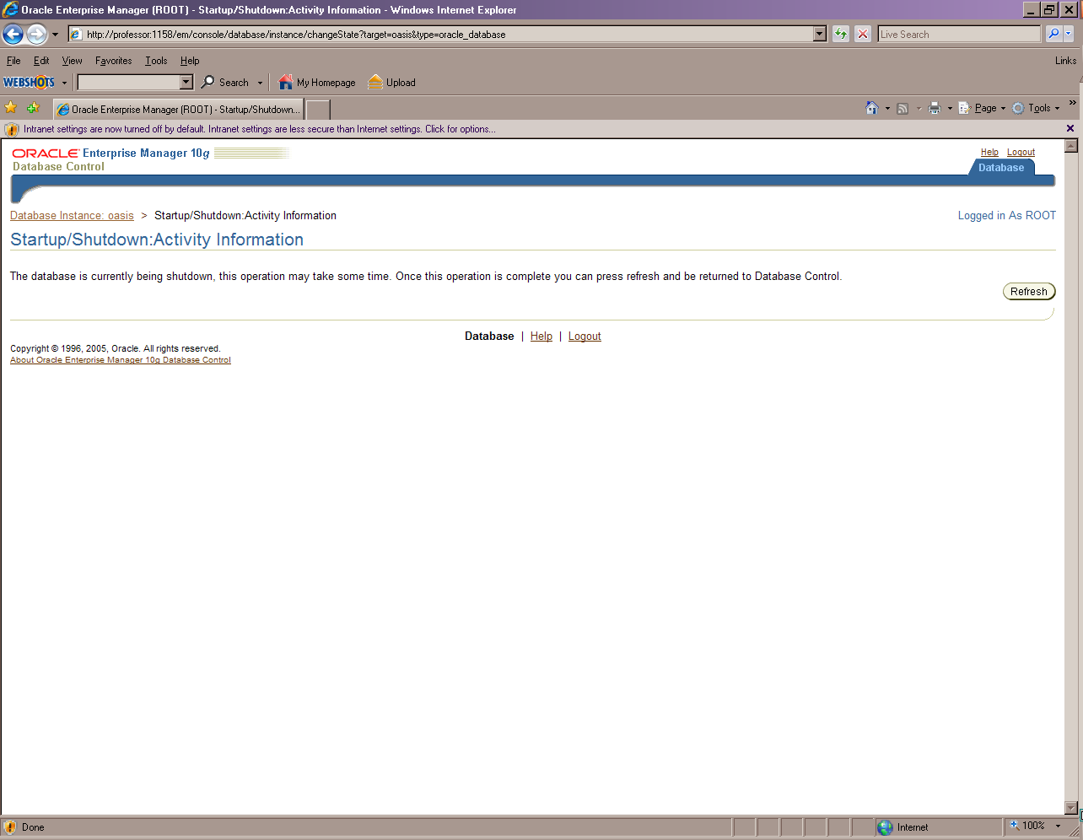
Slide17
The database is in the process of being shutdown. This may take a few minutes.

Slide 27
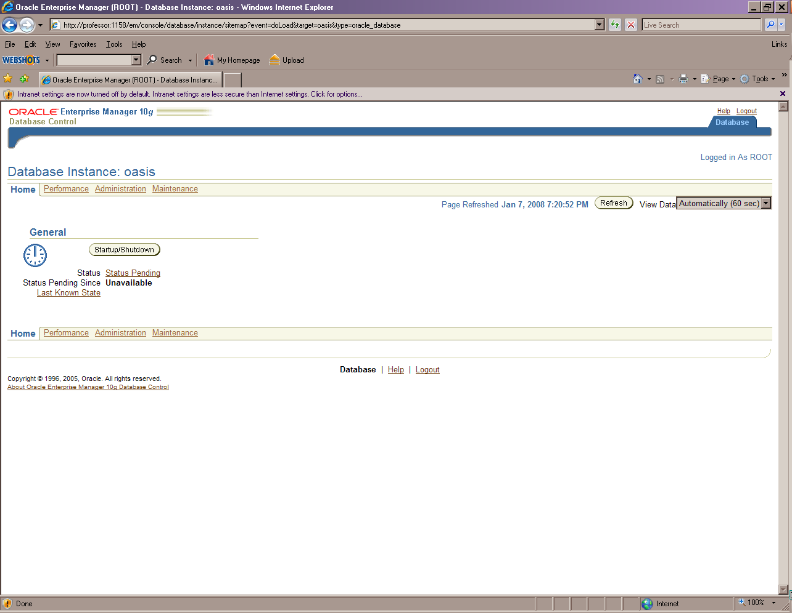
Slide18
The database is now shutdown and is not available to any users.
You can log out of the Enterprise Manager.

Slide 28
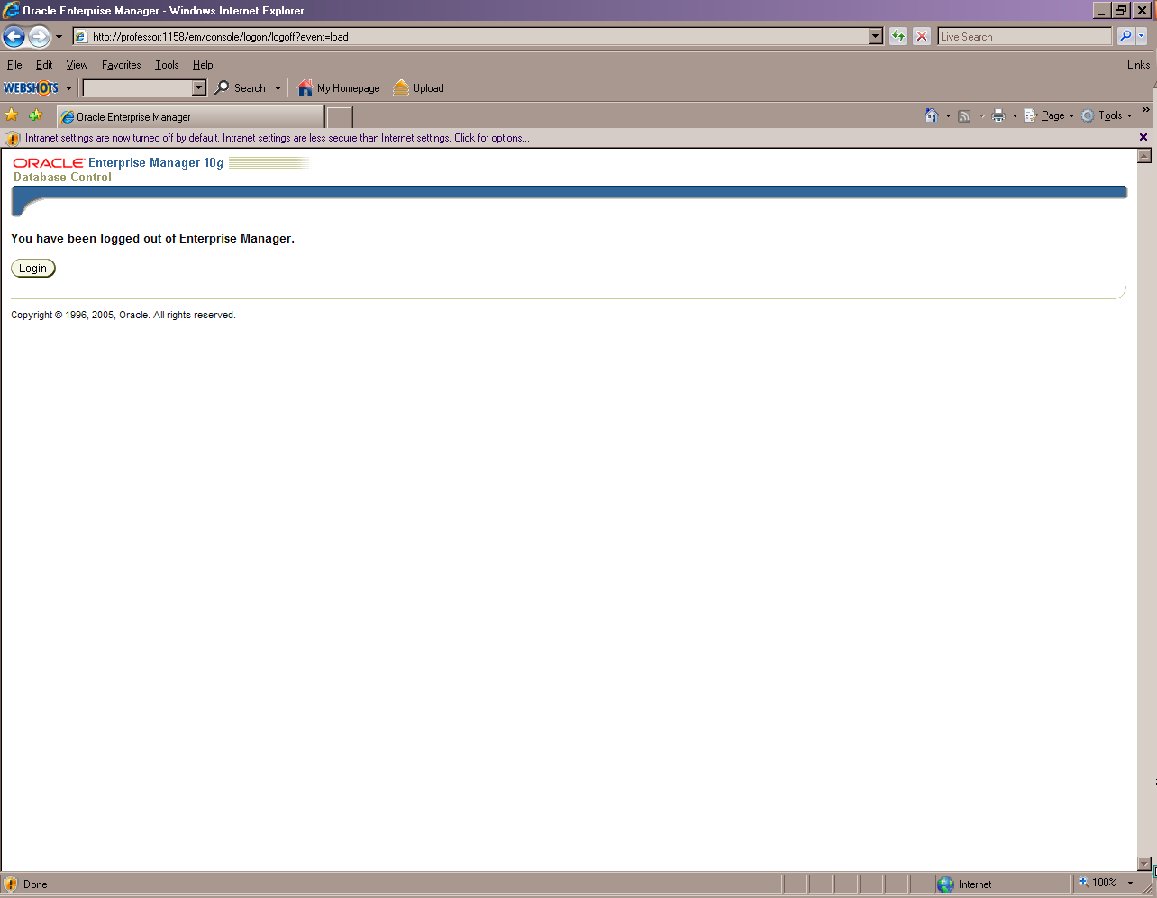
Slide19
You are now logged out of the Enterprise Manager.

